Slide 1
Serverless Gamble Chatroom
Practical Cloud Computing Platform - Final Project
Team2 - Yan-Hui, Lin & Pin-Yi, Li

Slide 2
TABLE OF CONTENTS
01
03
02
04
INTRODUCTION
DEMO
SYSTEM ARCHITECTURE
PROBLEMS

Slide 3
01
INTRODUCTION

Slide 4
User Story
本專題基於Azure Function之無伺服器服務搭建網路聊天室，透過此聊天室可與其他使用者於線上進行多人即時對話，在普通對話之餘還有點數博弈機制，使用者可透過指令進行點數博弈以賺取點數。
此專題透過WebApp Service、Azure Function、SignalR、CosmosDB、Queue Storage來搭建此服務，使用者只須透過前端的WebApp下達對話，後端即可根據前端所輸入之對話進行運算，並將結果輸出回前端。

Slide 5
Instruction
{Name} = User Name
{point} = User point
{b_point} = Bargain Point
Instruction | Description | User Input | Bot response
{All} | All of message | Hello, World! | -
!init | Initial Point | !init | init successful!
!point | Check out the point | !point | {Name}’s points is {point}
!gamble {b_point} | Gamble points | !gamble 1 | {Name} has won {b_point} points! {Name} Failed! {b_point} points! (σ′▽‵)′▽‵)σ
 | Gamble percent of points | !gamble 5%
 | Gamble all of the points | !gamble All
Error | {b_point} > {point} |  | {Name}, You only have {points} points
Error | No point |  | {Name}, Please Init First!

Slide 6
02
SYSTEM ARCHITECTURE

Slide 7
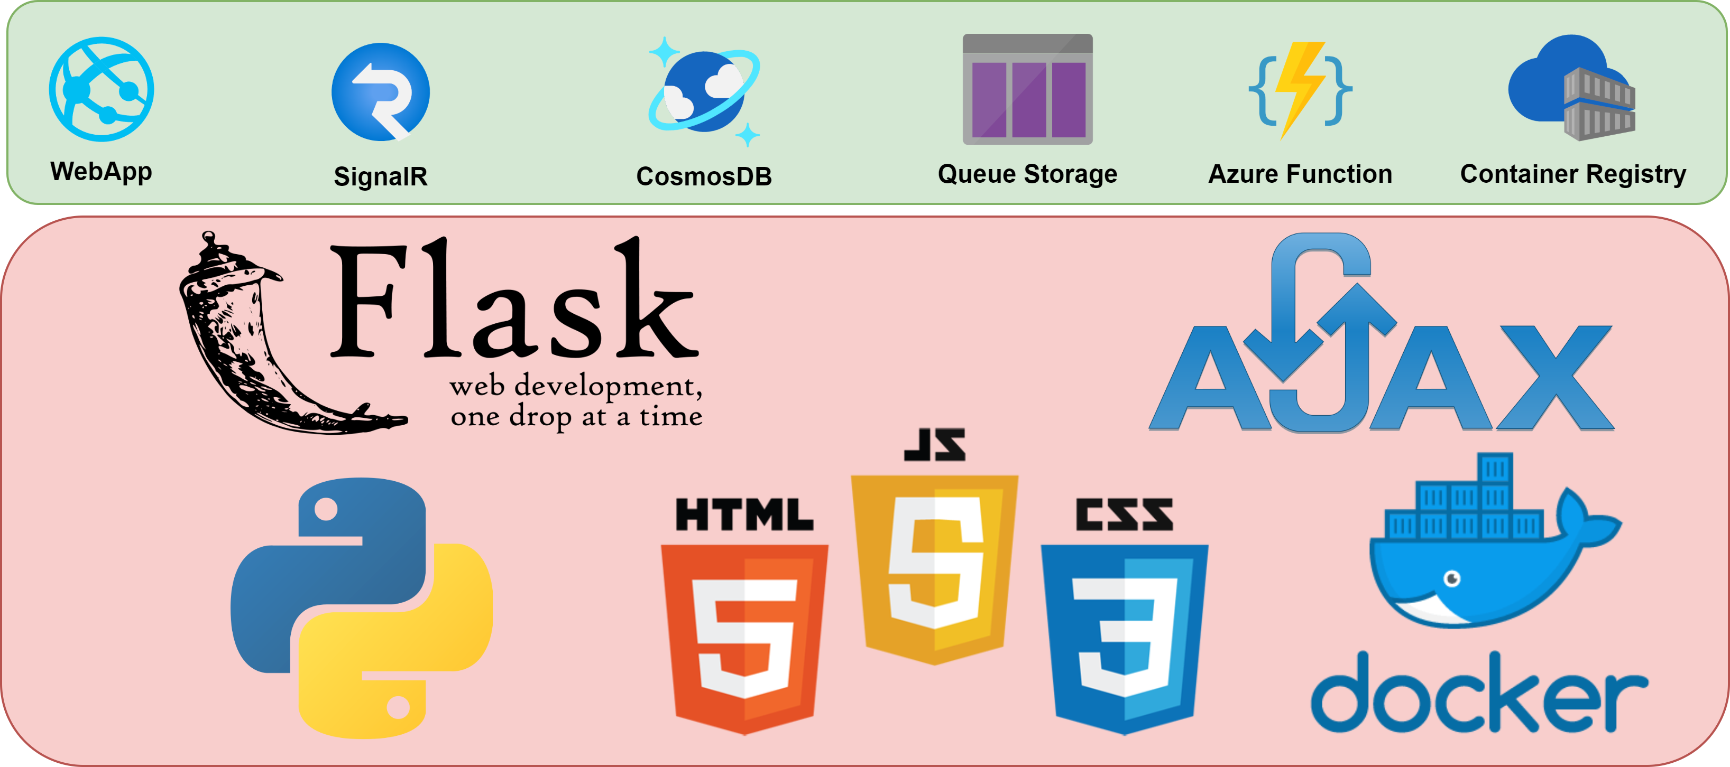
Resource & Technology

Slide 8

System Architecture

Slide 9
03
DEMO

Slide 10
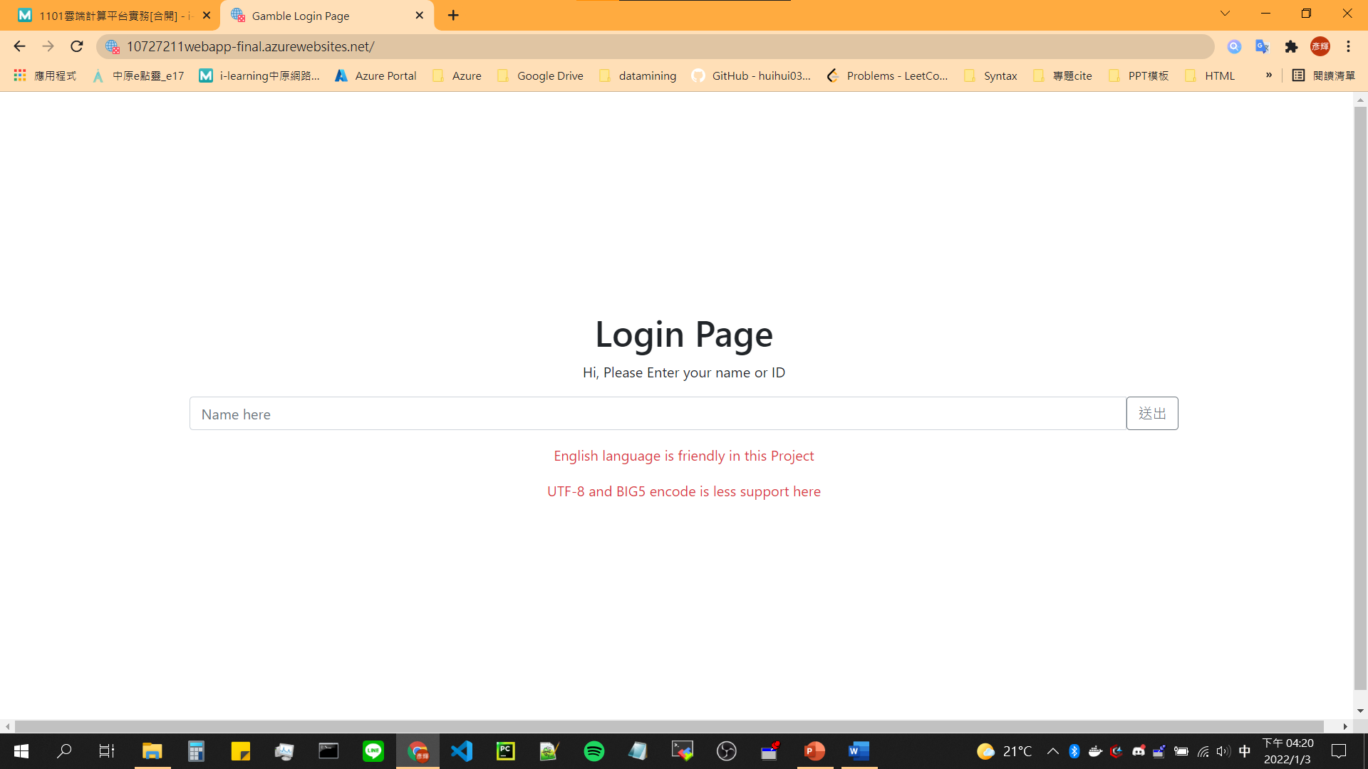
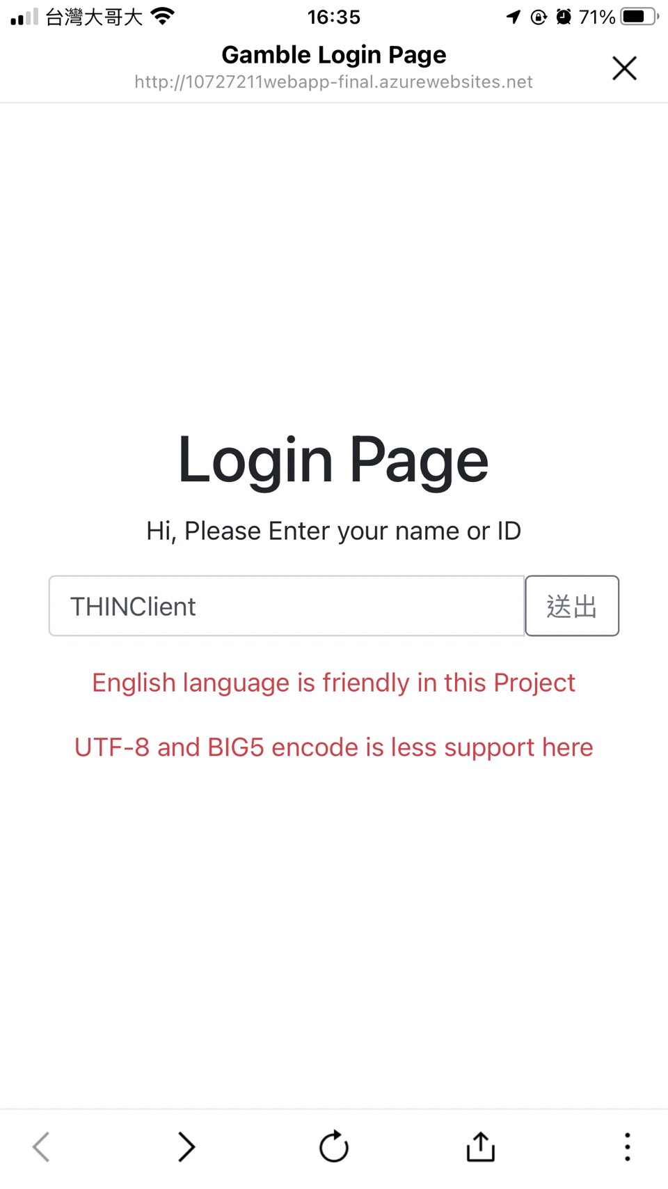

Desktop
Demo – Login Page
Mobile
https://10727211webapp-final.azurewebsites.net/

Slide 11
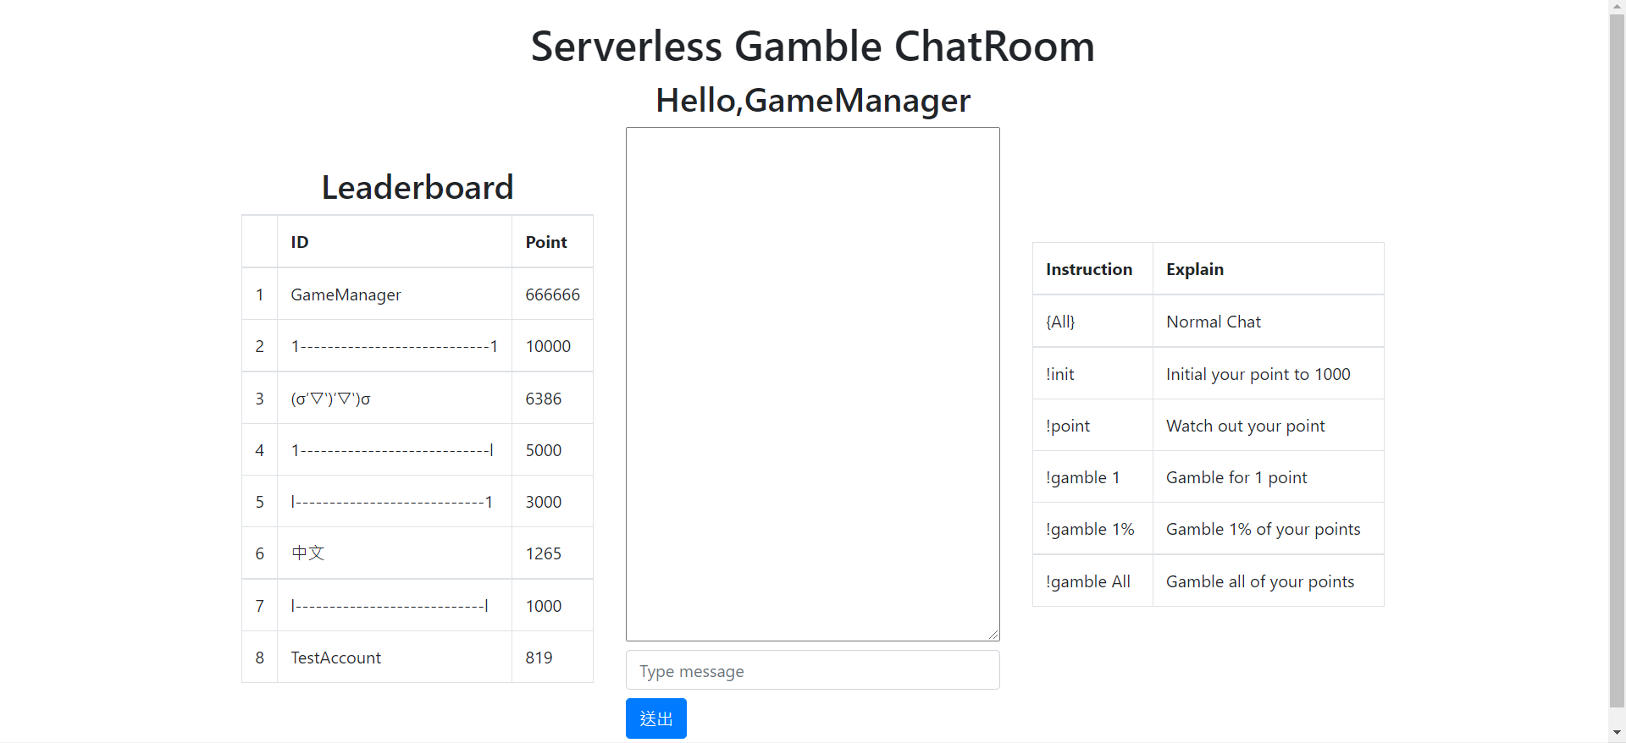
Demo - ChatRoom

Slide 12
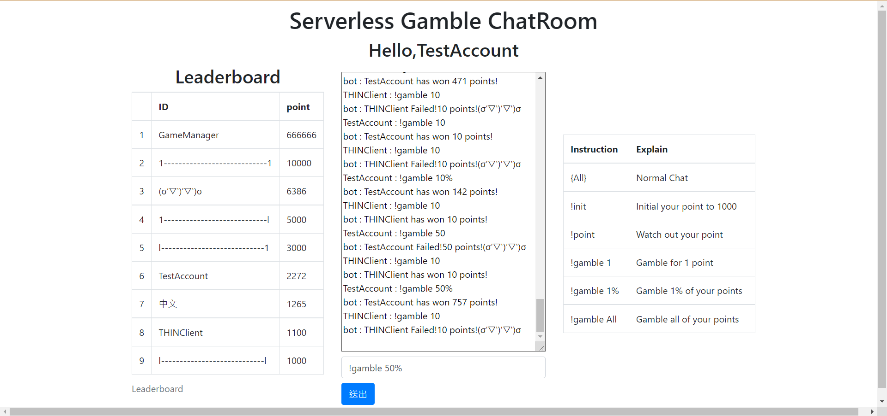
Demo – ChatRoom (cont’d)

Slide 13
04
PROBLEMS

Slide 14





Problems
Encode
GUI Extension
Socket
Document
Durable Function
Document Error
Notes:
GUI Extension -> Docker Container
Socket -> Learning from Tutorial
CosmosDB GUI Error -> Create from Python API
Queue Storage -> No
Durable Function -> Design Error
Document Error -> SignalR Tutorial Error

Slide 15
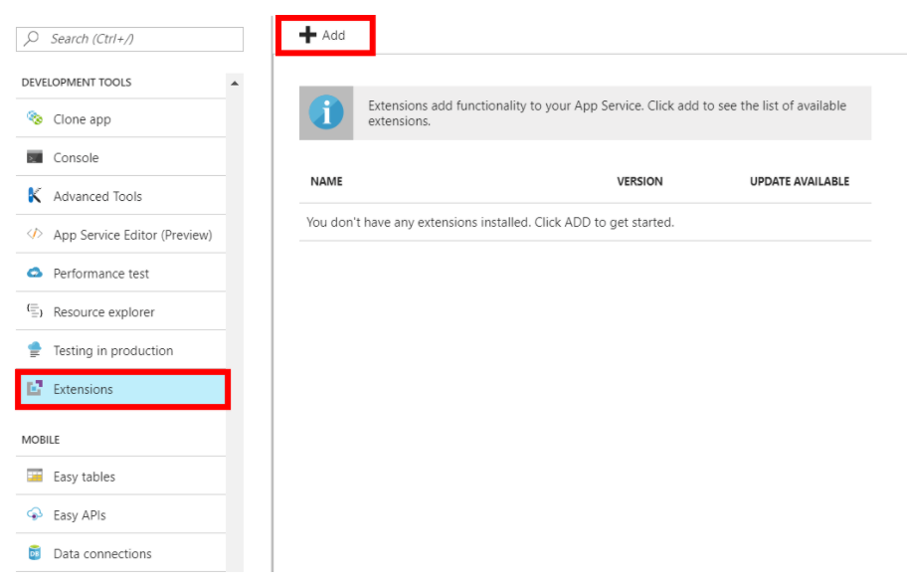
WebApp Extension
https://microsoft.github.io/AzureTipsAndTricks/blog/tip21.html

Slide 16
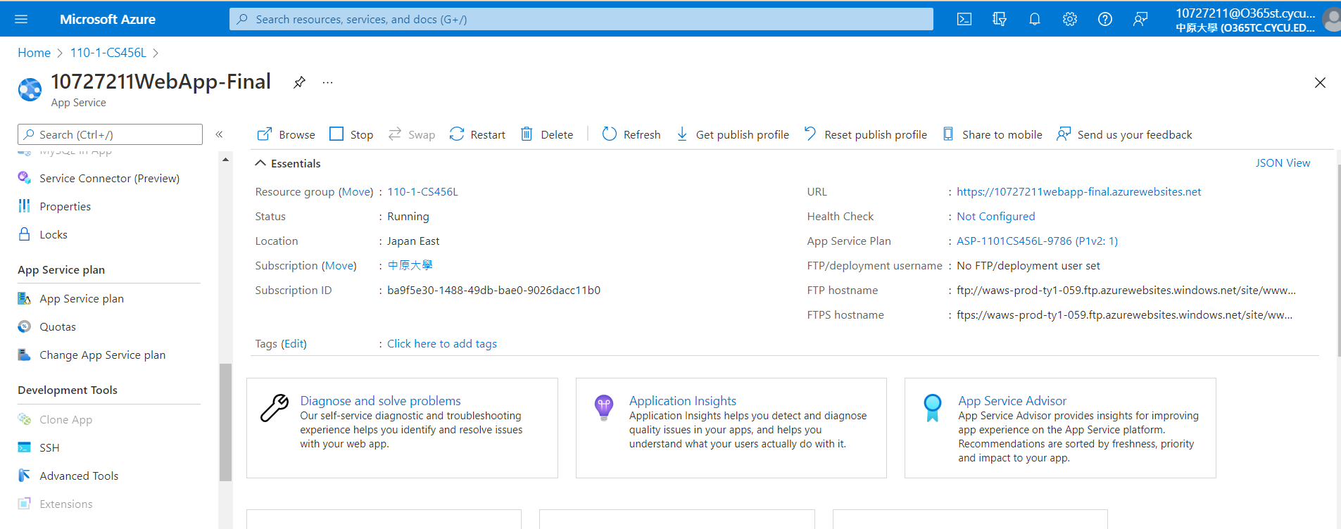
WebApp Extension (Cont’d)

Slide 17

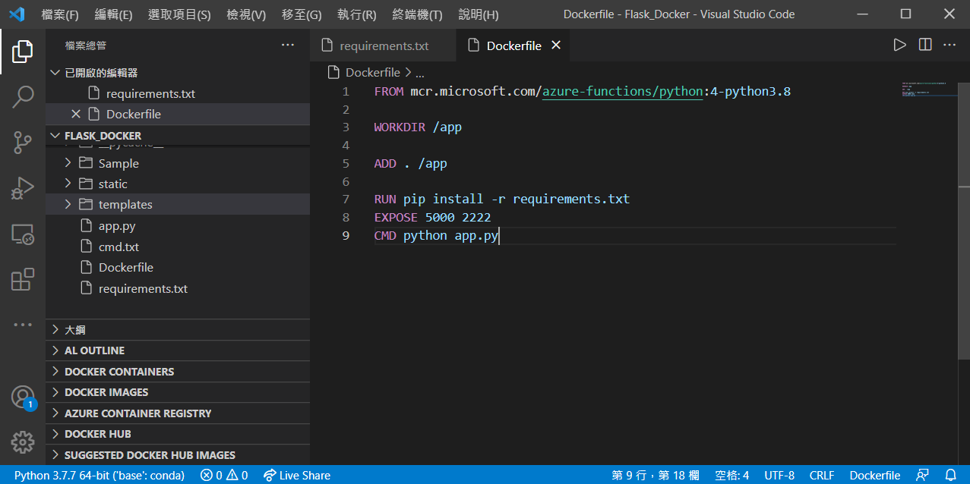
WebApp Extension (Cont’d)

Slide 18
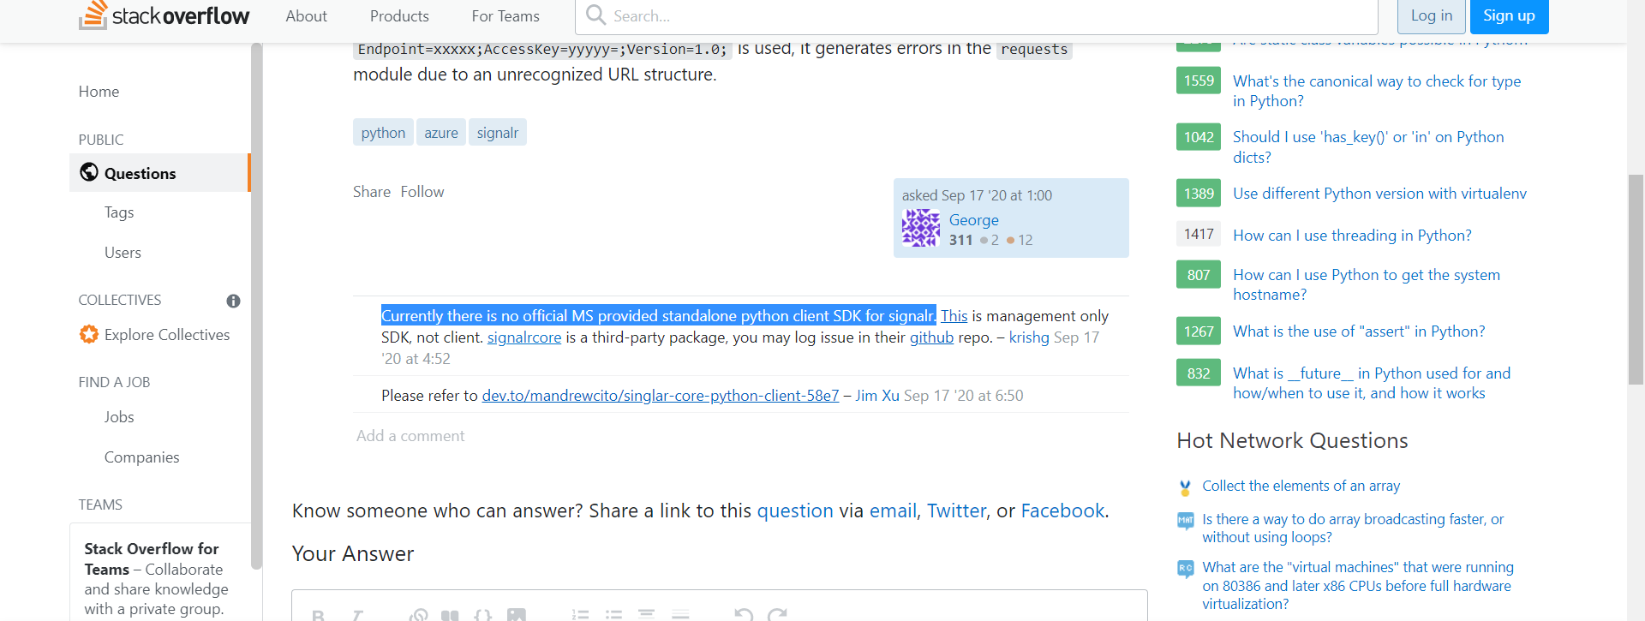
SignalR

Slide 19
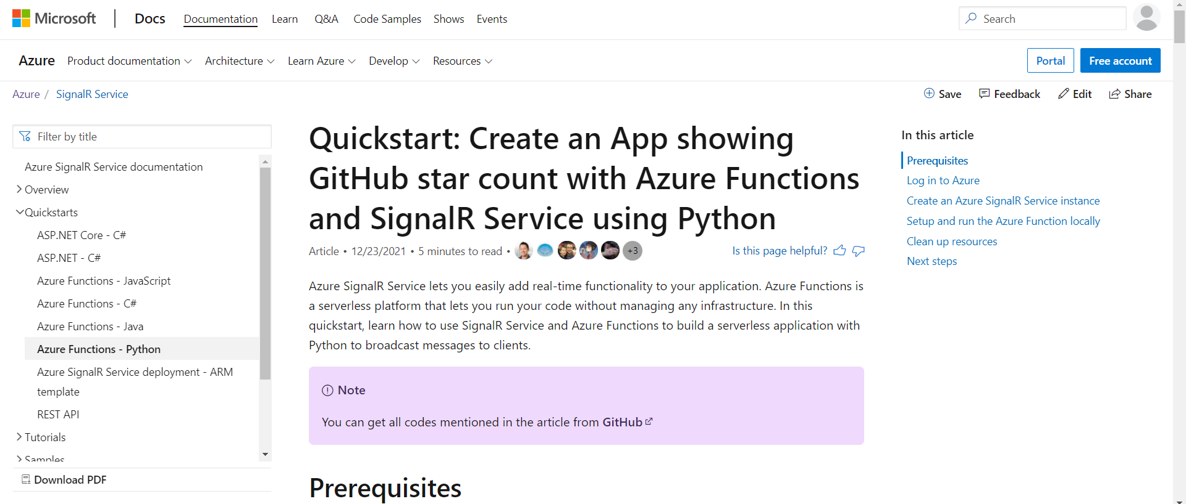
SignalR (Cont’d)
Error

Slide 20
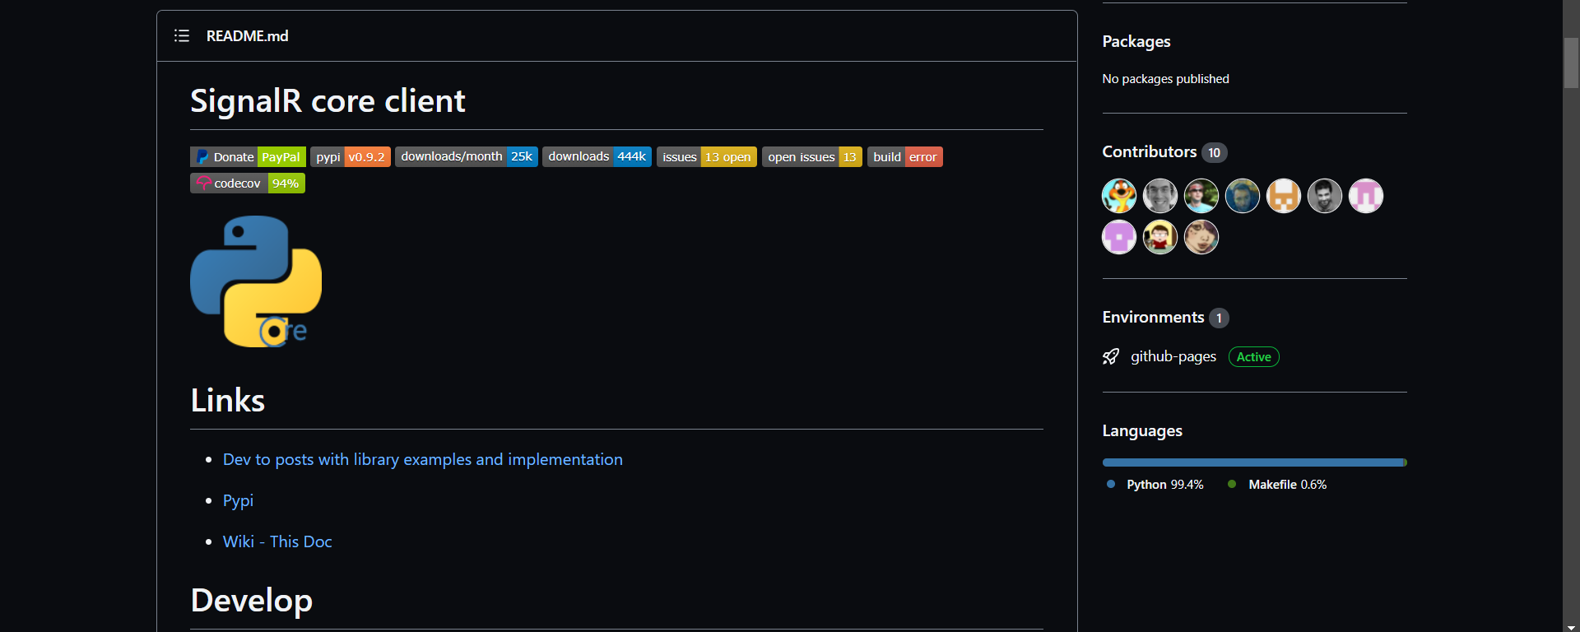
SignalR (Cont’d)
https://github.com/TargetProcess/signalr-client-py
https://github.com/mandrewcito/signalrcore

Slide 21
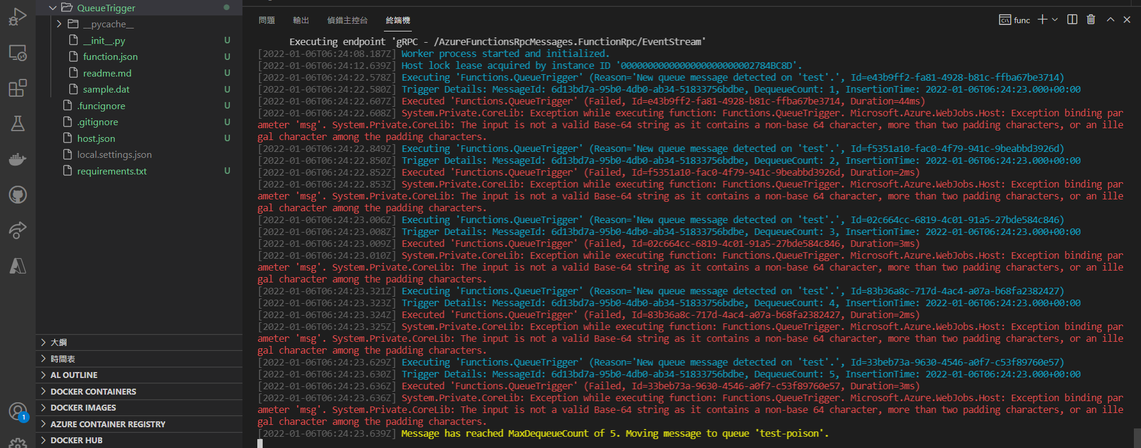
Queue Storage

Slide 22
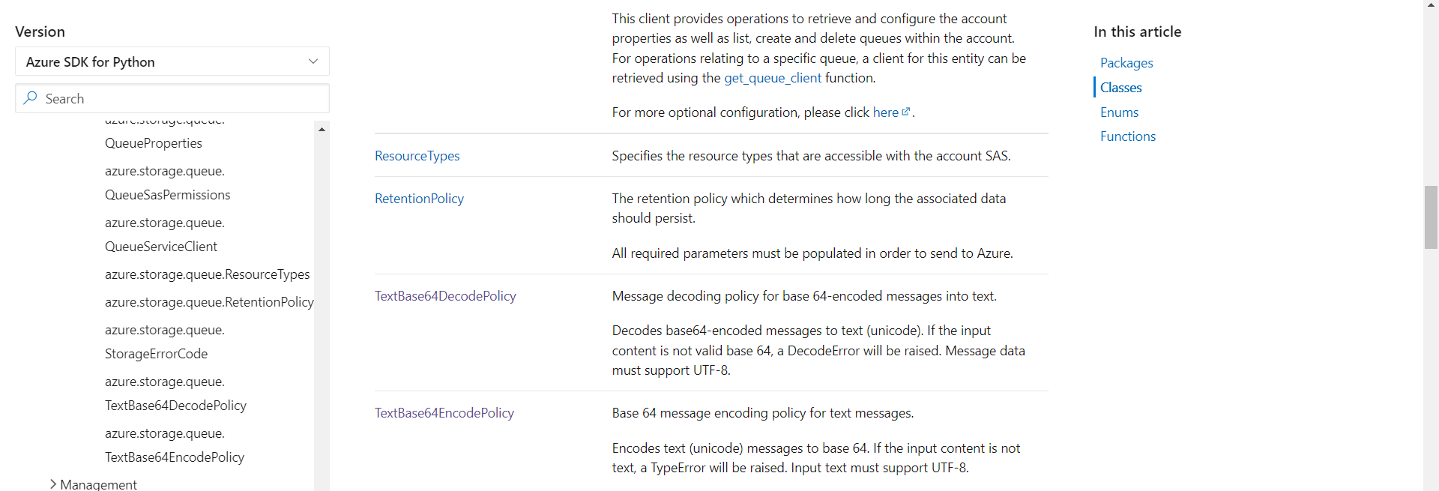
Queue Storage (Cont’d)
https://docs.microsoft.com/en-us/python/api/azure-storage-queue/azure.storage.queue?view=azure-python

Slide 23

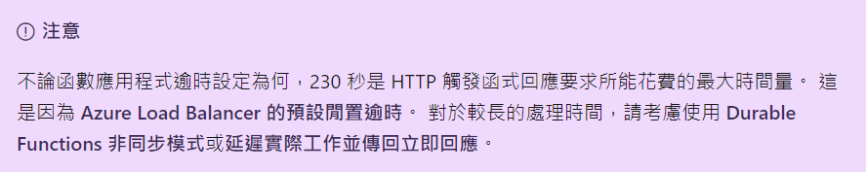
Durable Function

Slide 24
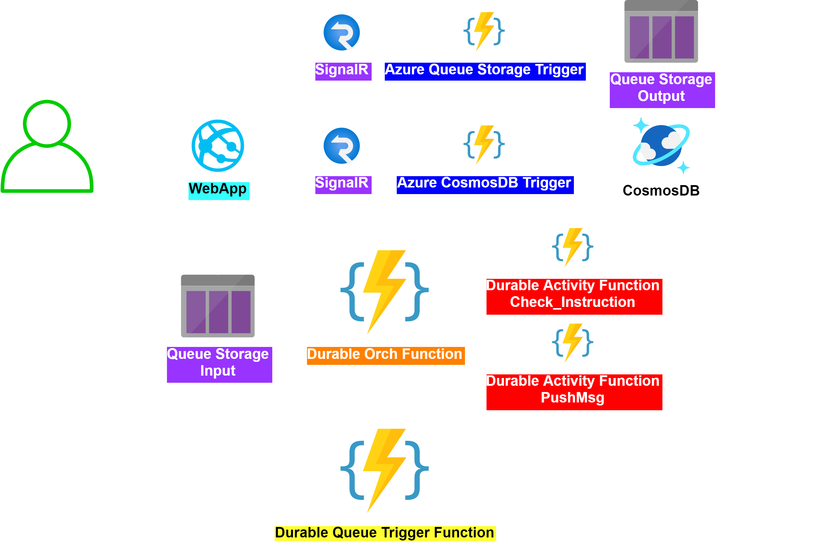
Durable Function (Cont’d)
Notes:
Orchestrator

Slide 25
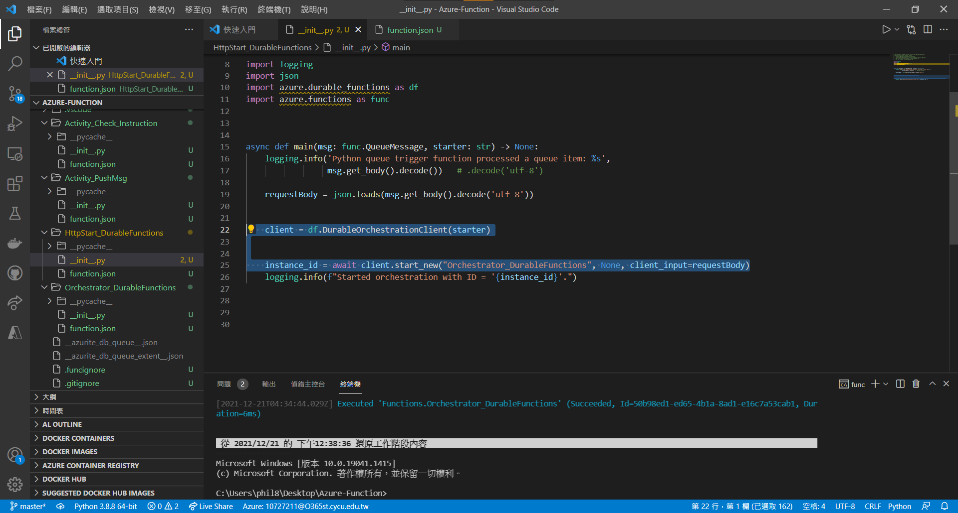
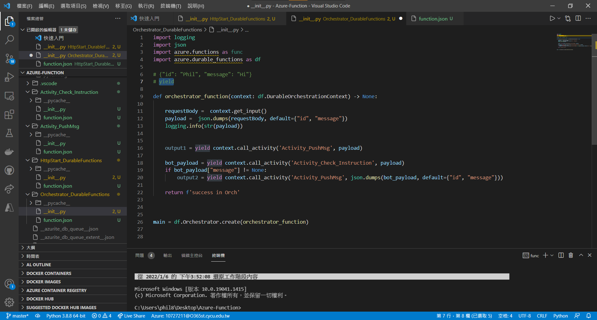
Durable Function (Cont’d)
HttpStart
Orchestrator

Slide 26
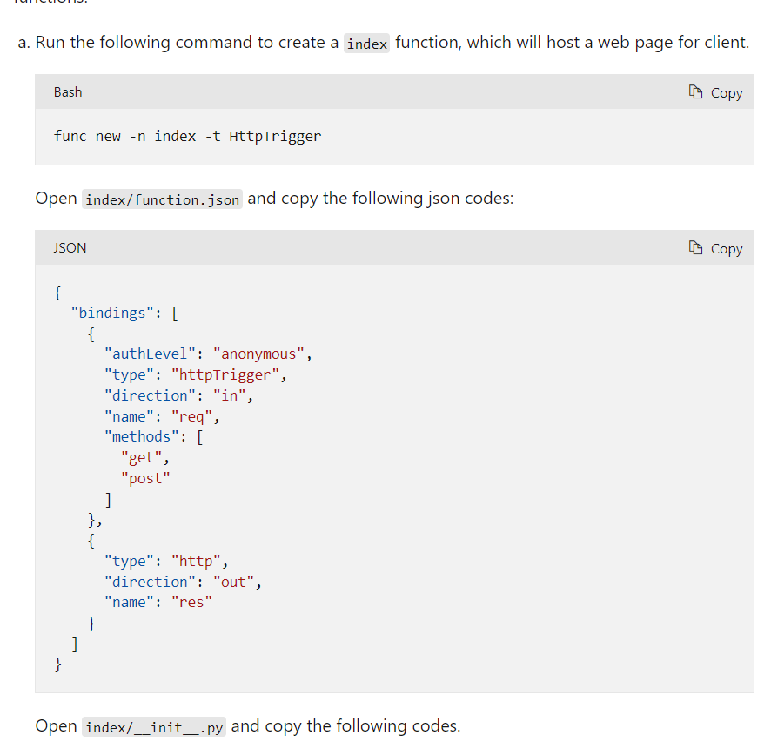
Document Error
https://docs.microsoft.com/en-us/azure/azure-signalr/signalr-quickstart-azure-functions-python

Slide 27
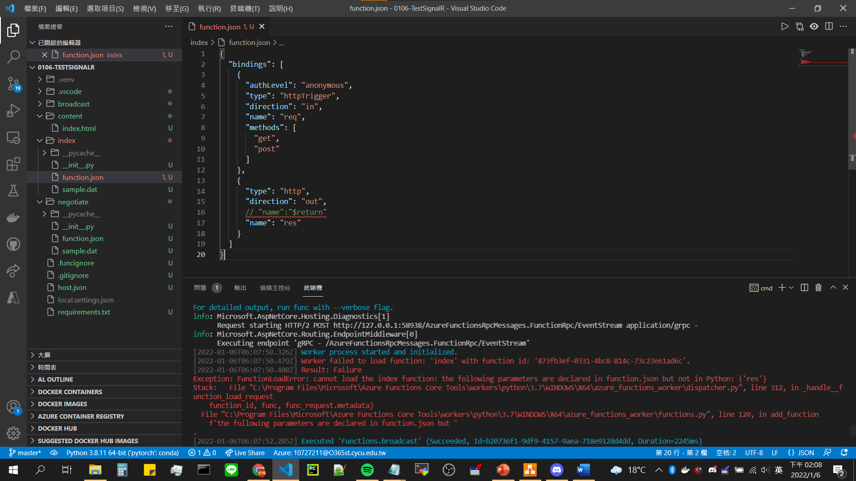
Document Error (Cont’d)

Slide 28
THANKS
Team2 – Serverless Gamble Chatroom

